Slide 1

Data warehousing Project
Digital Pioneers
Prepared by:
Team Name: Digital Pioneers
Beshoy Karam (Team Leader)
Fady Emad
Adel Emad
Ahd Montasser
Shahd Hussein
Dr: Wesam Ahmed

Slide 2
Content:
1. Introduction: The "Business Case“.
2. The Data Architecture (The "How").
3. The Data Model (The "Logic").
4. Analysis & Power BI (The "Insight").
5. Screens from Our Project.
6. Conclusion & Value.

Slide 3
1. Introduction: The "Business Case"
Problem Statement: Traditionally, sales data in Excel is "flat" and "static." It lacks historical tracking and makes it difficult to see relationships between different entities (like how a specific category performs across different months).
The Goal: To transition from Operational Data (Excel) to Analytical Data (Data Warehouse).
Define exactly what you are measuring:
Gross Profit: Total Sales - Cost of Goods Sold (COGS).
Sales Volume: Total units (pieces) sold.
Product Penetration: Which products are moving the fastest.

Slide 4
2. The Data Architecture (The "How")
In this part we will describe the ETL process (Extract, Transform, Load)
Data Source Layer: our8 source was Excel, which represents "unstructured" or "semi-structured" raw business data.
Staging Area (The "Buffer"): This is crucial. Tell them you used a staging area to:
Cleanse: Remove null values or fixing "messy" product names.
Standardize: Ensure all currency and date formats are uniform before they hit the SQL database.
Data Warehouse Layer (SQL): This is the permanent, structured storage where data is optimized for reading and reporting, not just storage.

Slide 5
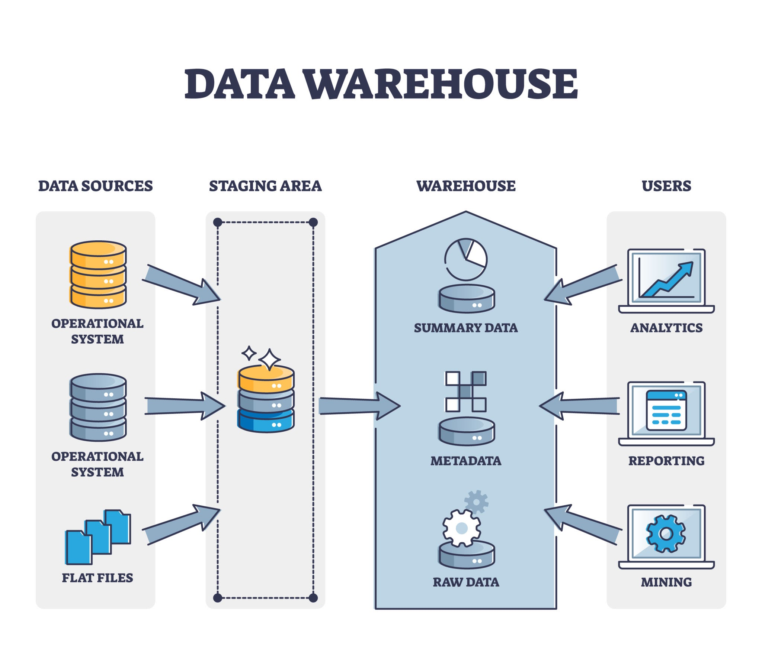

Slide 6
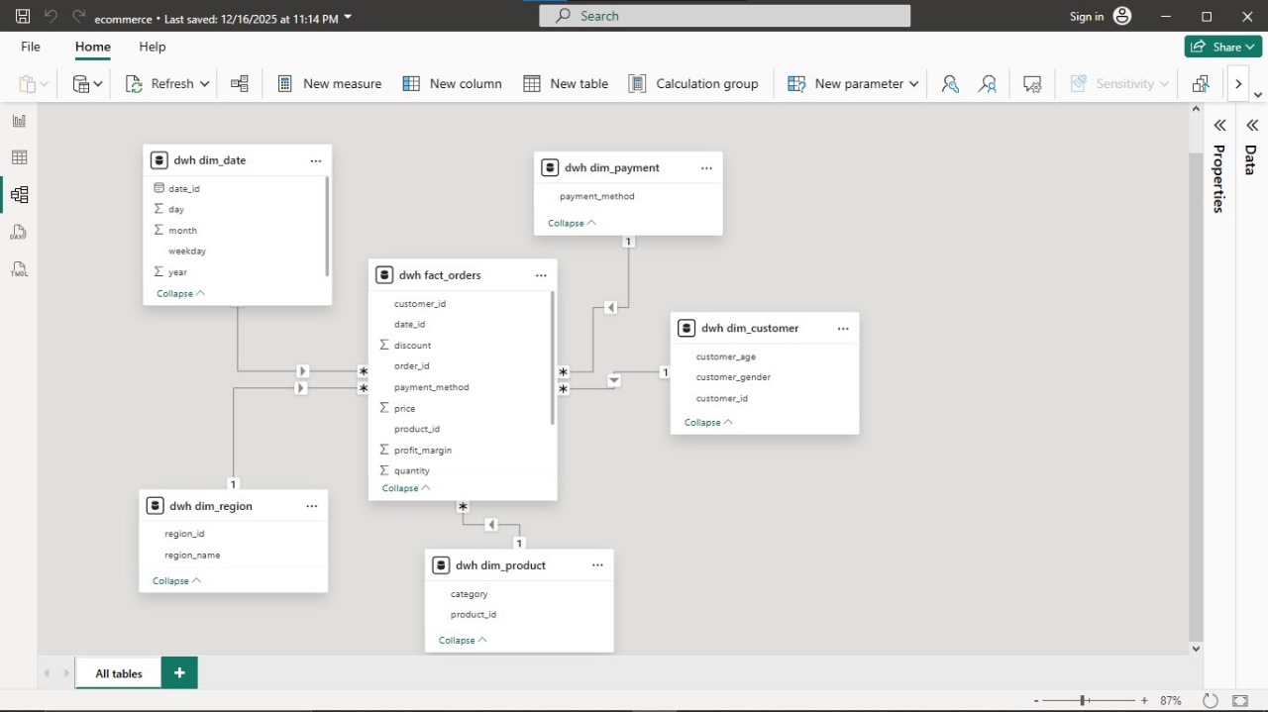
3. The Data Model (The "Logic")
Our data model follows a Star Schema architecture, designed to optimize query performance and simplify the analytical process within Power BI.

Slide 7
A. The Central Fact Table: dwh_fact_orders
This is the core of our warehouse. It captures every business event (an order) and stores the numerical data we need for calculation.
Keys for Integration: It contains Foreign Keys such as customer_id, date_id, product_id, and region_id to connect with our descriptive dimensions.
Core Metrics: We store the fundamental values here: price, quantity, and discount.
Derived Logic: We included a profit_margin field directly in the fact table to allow for immediate profitability analysis without complex runtime calculations.
Granularity: The "grain" of this table is a single order line item, ensuring we can aggregate data up to any level (e.g., total sales by region or average profit by customer gender).

Slide 8
B. The Dimension Tables (The Descriptive Entities)
We created five distinct dimension tables to provide context to our order data:
dwh_dim_date: Enables time-series analysis through attributes like day, month, weekday, and year. This allows us to track "Pieces Sold" over specific calendar periods.
dwh_dim_product: Stores product metadata, specifically category. This is essential for identifying which product lines are the most profitable.
dwh_dim_customer: Contains demographic data like customer_age and customer_gender, allowing us to see which audience segments are buying the most pieces.
dwh_dim_region: Organized by region_id and region_name to visualize geographic sales performance.
dwh_dim_payment: Tracks the payment_method used for each order, helping us understand customer purchasing behavior.

Slide 9
C. Relationship Logic & Schema Integrity
Star Schema Efficiency: As seen in our model diagram, the dwh_fact_orders table is at the center, surrounded by dimensions. This reduces the number of "joins" needed, making the Power BI dashboard faster.
1:N (One-to-Many) Relationships: We established 1:N relationships between the dimensions and the fact table. For example, one entry in dwh_dim_product can relate to many rows in dwh_fact_orders.
Directional Filtering: The filters flow from the Dimension tables to the Fact table (represented by the arrows in the diagram). This ensures that when we select a specific "Category" in our dashboard, it correctly filters the "Total Profit" in our Fact table.

Slide 10
4. Analysis & Power BI (The "Insight“)
In this phase, we transformed the structured data from our SQL Warehouse into a visual "Semantic Layer." This allows stakeholders to move from viewing rows of data to identifying business trends instantly.

Slide 11
A. Core Metrics.
We utilized high-level "Card" visualizations to provide an immediate snapshot of the business's health:
Total Revenue: indicating a high-volume operation.
Profit Performance: which is our primary indicator of business success beyond just sales.
Inventory Throughput: helping us understand the scale of physical product movement.

Slide 12
B. Visual Analysis & Behavioral Trends
Demographic Profitability (Line Chart): We analyzed the relationship between customer_age and sales. This line chart reveals how different age groups contribute to revenue, allowing us to target marketing toward the peaks seen in the data.
Regional Performance (Bar Chart): By plotting region_name, we discovered that the South and North regions are leading in sales, while the Central region is currently the lowest performer.
Gender Distribution (Donut Chart): Our customer base is almost evenly split, with Females slightly outperforming Males. This insight is crucial for product procurement and inventory planning.

Slide 13
C. Operational & Payment Analysis
Integrating the dwh_dim_payment and shipping data allowed us to see how customers interact with the business:
Payment Preferences: Credit Cards are the dominant payment method.
Shipping Costs by Region: We tracked the Max of shipping_cost per region.
Discount Impact: Our analysis shows a sharp decline in sales volume as discount levels increase.

Slide 14
D. Operational Efficiency & Behavior
Payment Method Impact: Credit Cards.
Logistics Overhead: identifying a clear area for cost reduction.
Discount Sensitivity: Our analysis shows that volume peaks at 18.9K when discounts are at 0%, suggesting that our customers are currently more driven by product value than price-slashing.

Slide 15
Screens from Our Project.

Slide 16
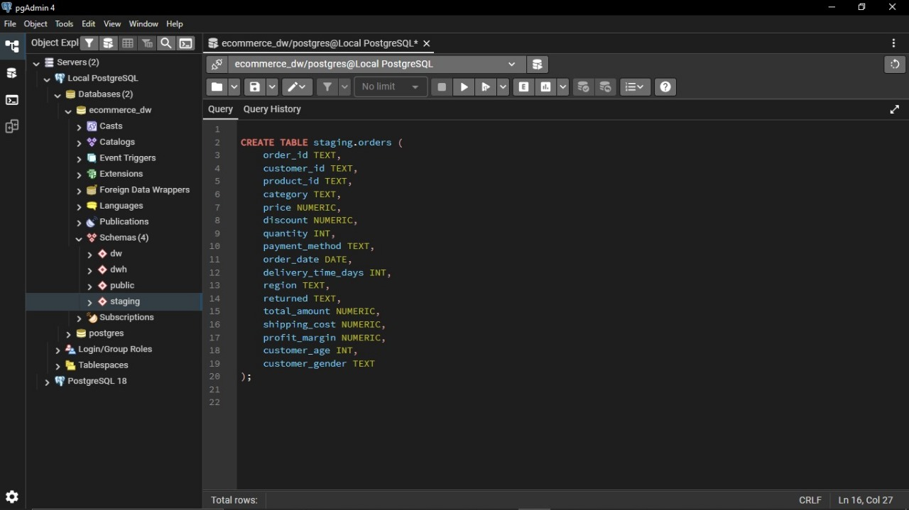

Slide 17
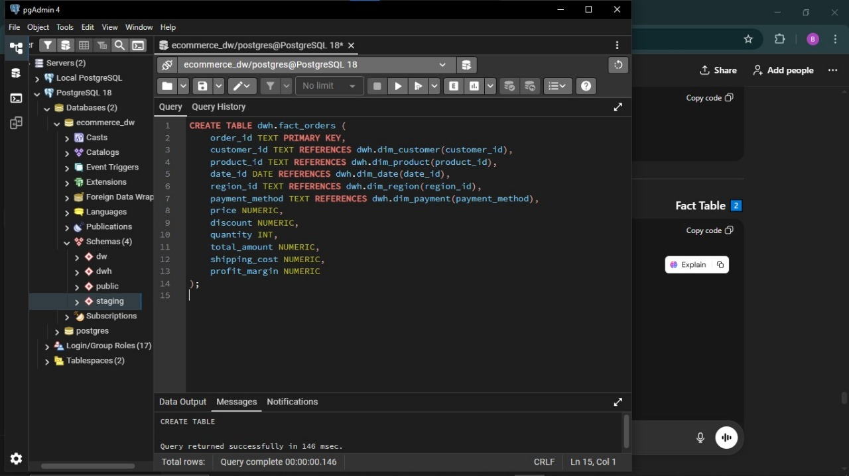

Slide 18
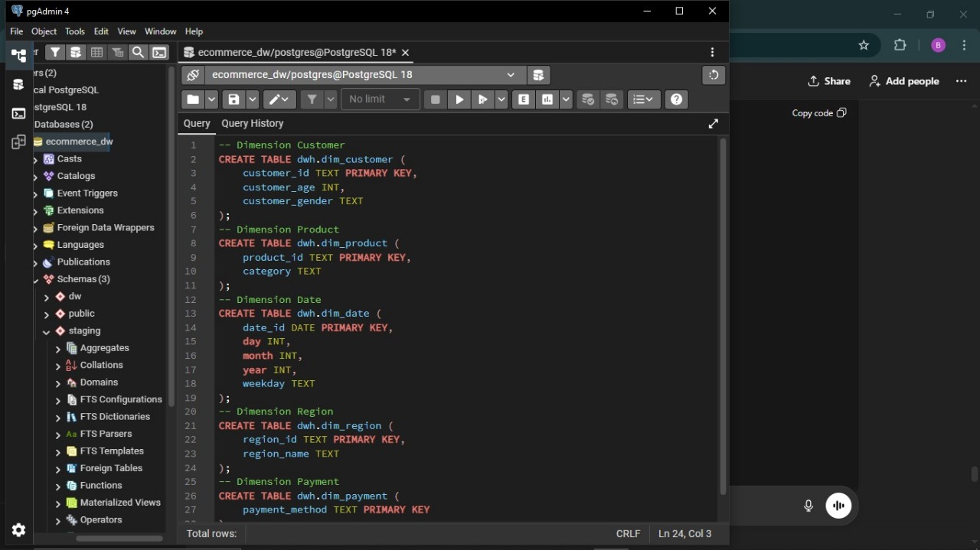

Slide 19
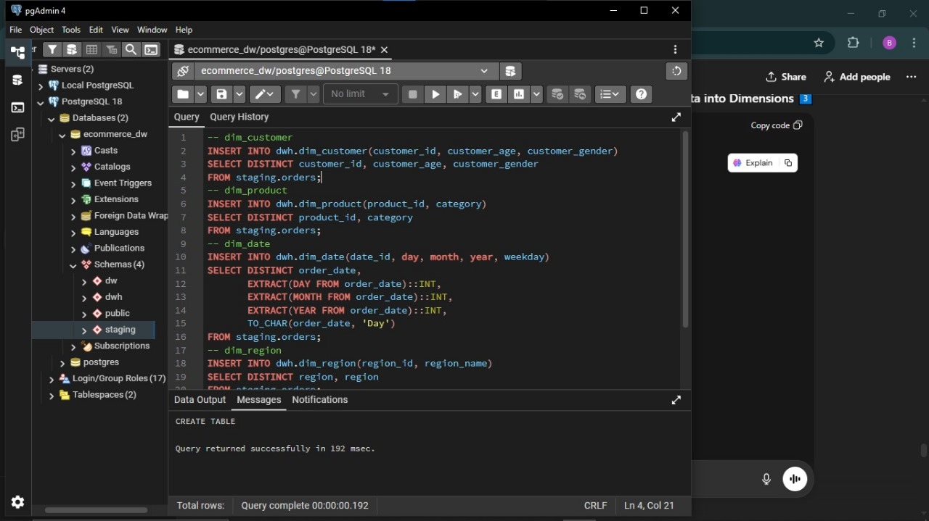

Slide 20
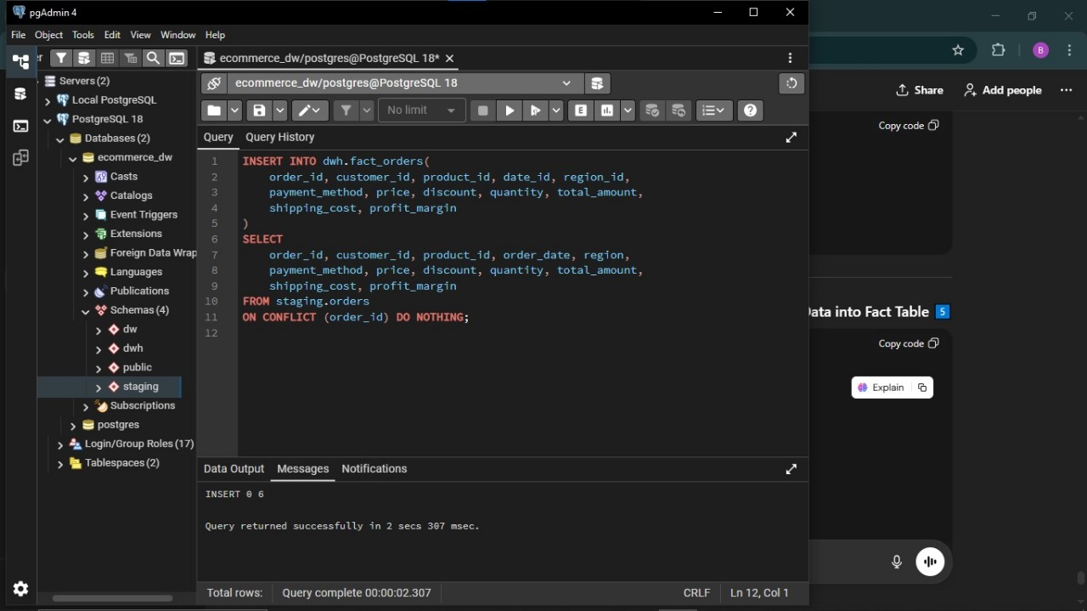

Slide 21
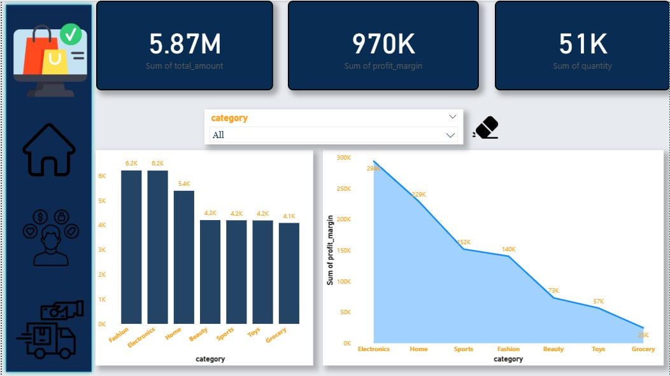

Slide 22
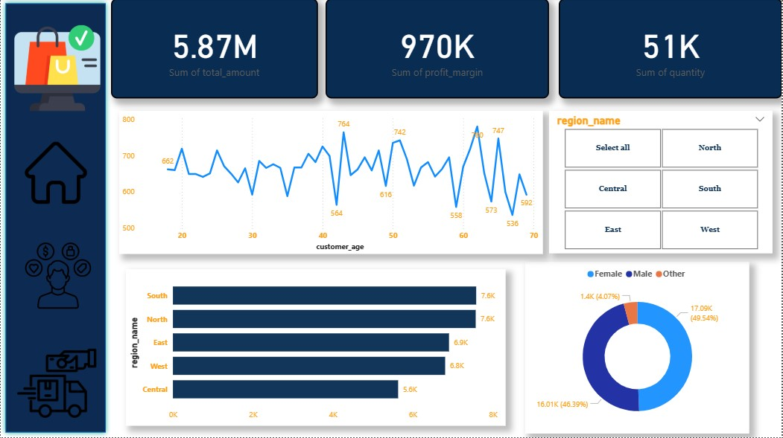

Slide 23
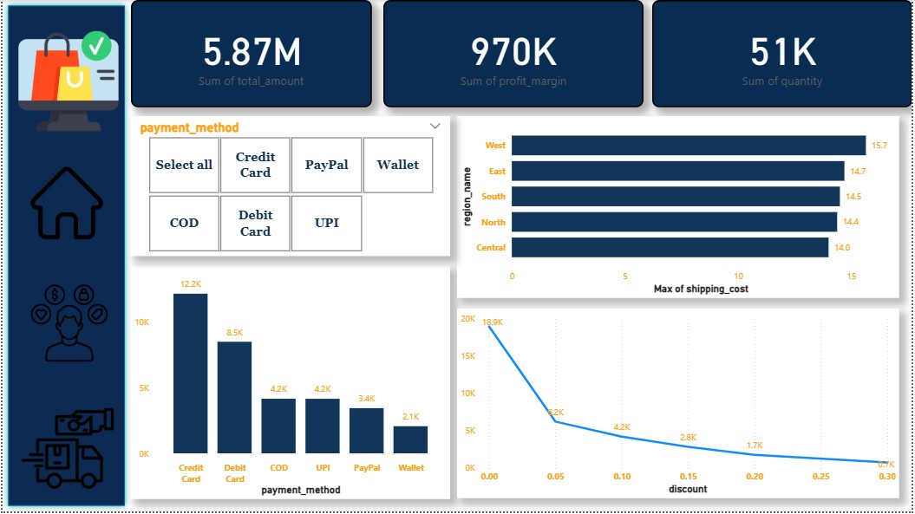

Slide 24
6. Conclusion & Value.
This project successfully bridged the gap between raw data collection and strategic decision-making.
From Data to Strategy: We can now see that while we sell many "pieces" in Fashion, our true "profit" engine is the Electronics category.
Scalability: Because we built this in a SQL Star Schema rather than a flat Excel file, this warehouse can handle future growth without needing to redesign the logic.
Final Impact: We have created a transparent, automated system that gives the business a Single Version of the Truth for every piece sold and every dollar earned.

Slide 25

Bye-Bye

